Slide 1
Dramatic Scoring
Paul Dougall

Slide 2
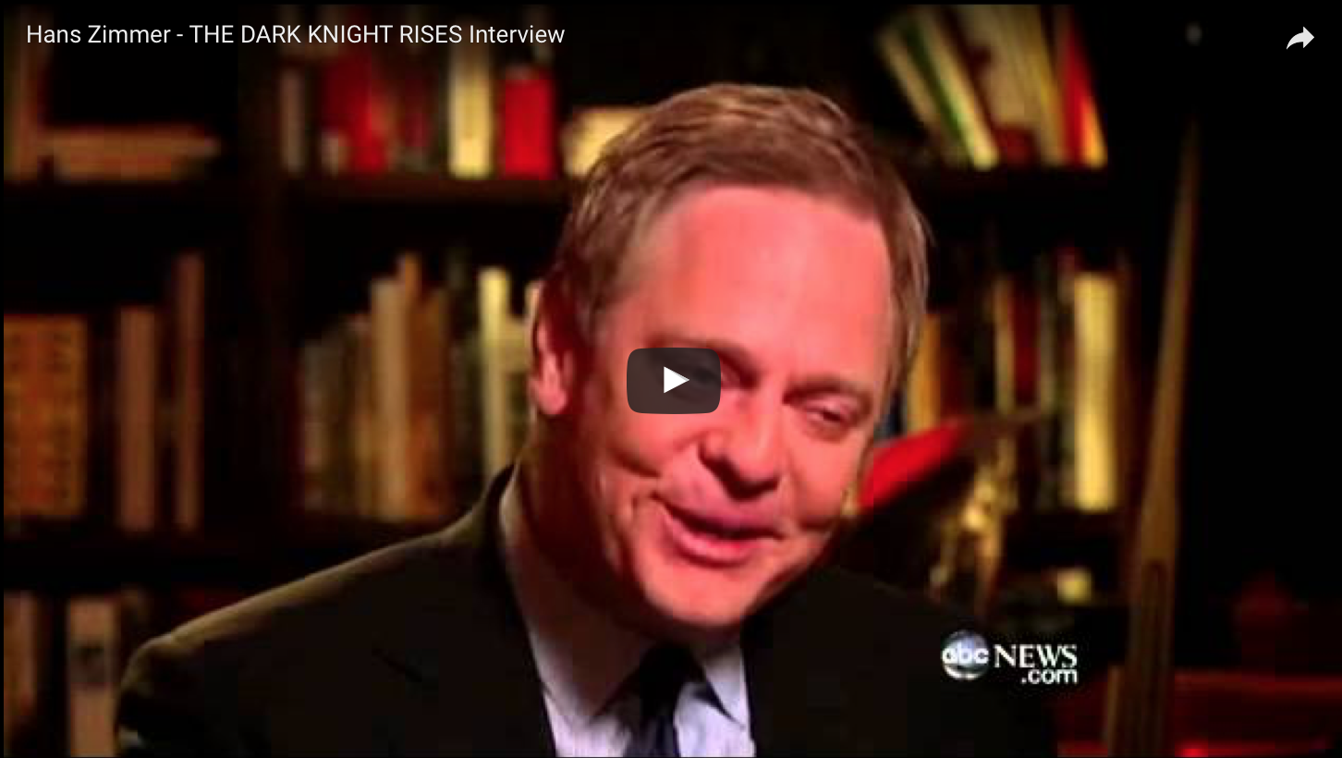

Slide 3
What is Dramatic Scoring?
Composing
Spotting
Orchestrating
Copying
Recording
Mixing
Editing
Synching
Films
TV Shows
Documentaries
Educational Videos
Video Games
Advertisements
Notes:
So what is dramatic scoring? You might be thinking that it is composing music for movies. And while you aren’t wrong, there’s a lot more to it then that

Slide 4
The Process
Spotting
Composing
Arranging/
Orchestrating
Recording
Copying
Mixing
START
Finished Score

Slide 5
Who’s Involved
Composer - Writes the music
Orchestrator – Orchestrates the music
Copier – Makes the physical score
Music Editor – Creates temp score
Musicians – People to perform the music for the recording
Mixer – Adjusts the sound levels of recordings
Studio Engineers – Work the recording equipment
Music Supervisor – Decides what pre-existing music to use and obtains licenses
Librarian – Upkeeps production music libraries

Slide 6
Tv Shows
Original Score, Synch License, or Production Music Library
“Needle Drops” vs. “On Camera”
Importance of the scene/episode

Slide 7
Video Games

Slide 9
Musical Blocks
Intro
Loop
Transition
Intro
Stinger
Tag

Slide 10
Video Game: Business
“Work for hire”
No performance
royalties
Full time job?

Slide 11
Websites
**http://midnightmusic.com.au/2016/06/the-guide-to-composing-music-for-video-games/
**http://www.thembj.org/2008/06/dan-carlin-the-new-business-of-film-scoring/
**http://www.avclub.com/article/insider-explains-world-music-supervision-220752
http://www.gamesoundcon.com/single-post/2015/08/08/6-Surprising-Facts-About-Composing-Music-for-Video-Games
https://www.bmi.com/news/entry/10_things_you_need_to_know_about_placing_music_on_tv_and_in_films
https://moviepilot.com/posts/1436093
https://reelrundown.com/film-industry/Music-in-Film
https://music.tutsplus.com/tutorials/the-process-of-score-composition-part-1--audio-1322
http://www.filmmusicmag.com/kb/categories/Getting+Into+the+Film+and+Television+Music+Business/
http://nofilmschool.com/2014/10/process-scoring-your-films-just-became-insanely-simple

Slide 12
Contact Information
School e-mail: dougalpe199@potsdam.edu
Personal e-mail: paldougall@gmail.com

